Slide 1
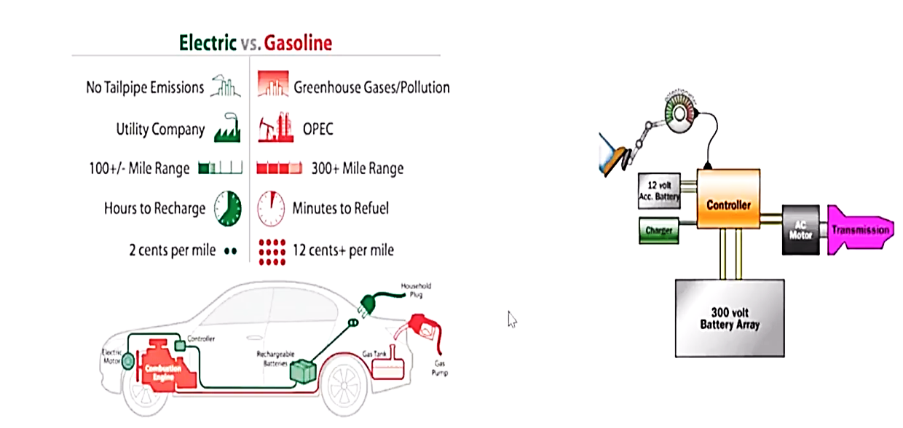
Electric vs. Gasoline

Slide 2
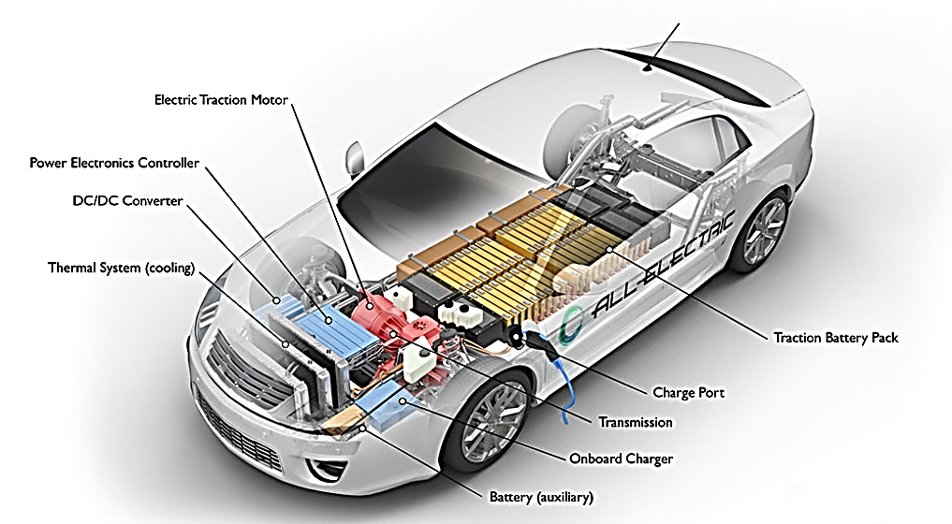
Electric Vehicle

Slide 3
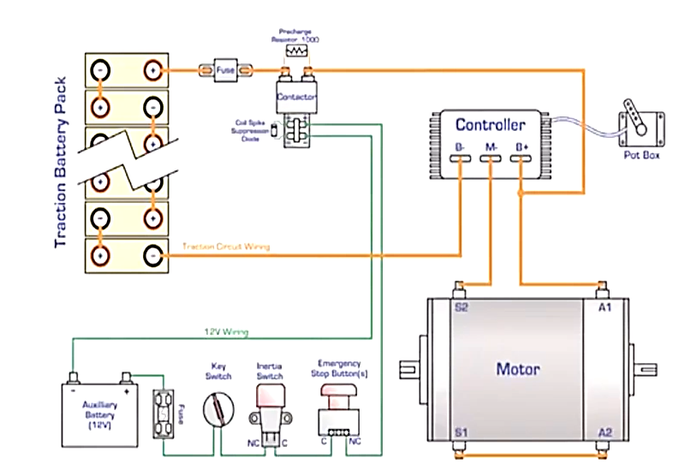
Electrification Approach

